Slide 1
SOFTWARE ENGINEERING
INTRODUCTION Of SOFTWARE:
1.It is a systematic, disciplines, cost effective techniques for software development
2.engineering approach to develop a software.
Evolution:
1945-65 ………… Origin …………
1965-85 ………… Crisis ………….
1990-2000 ……… Internet ………..
2000-2010 ……… Light weight
2010-Till ………... AI,ML,DL

Slide 2
SDLC
1. Software development life cycle (SDLC) is a structured process that is used to design, develop, and test good-quality software.
2. SDLC, or software development life cycle, is a methodology that defines the entire procedure of software development step-by-step.
3. To develop a software we will follow the different stages.

Slide 3
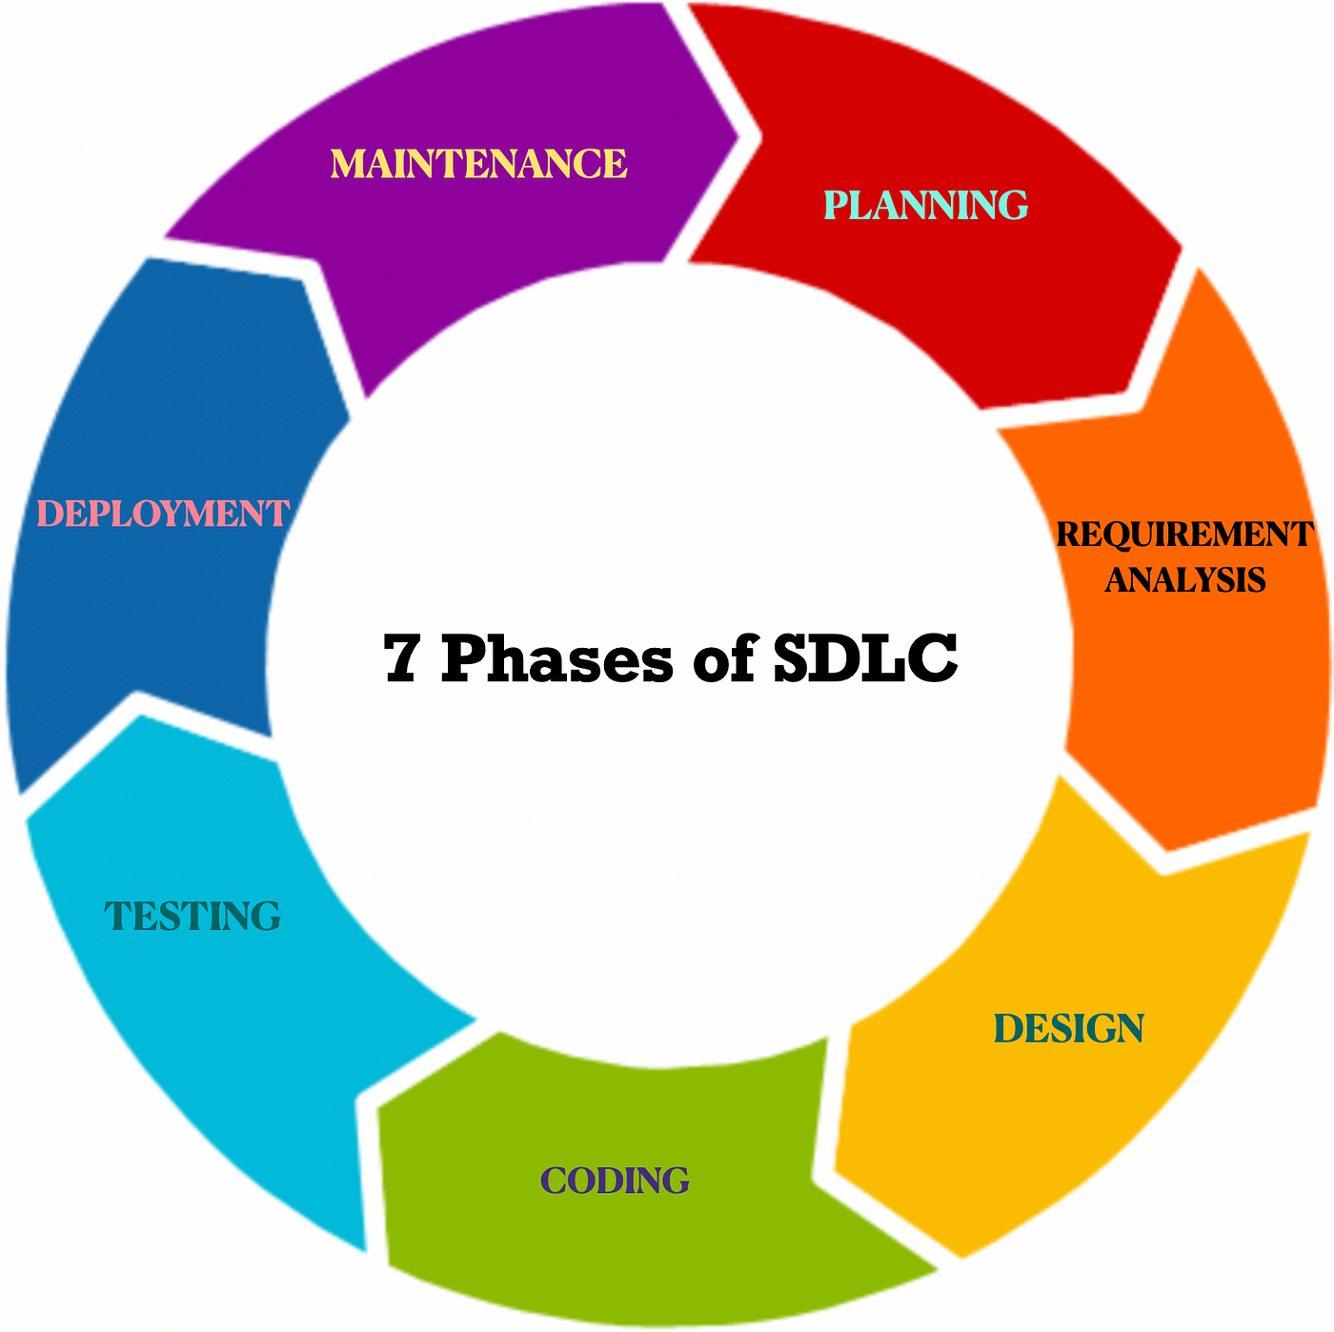
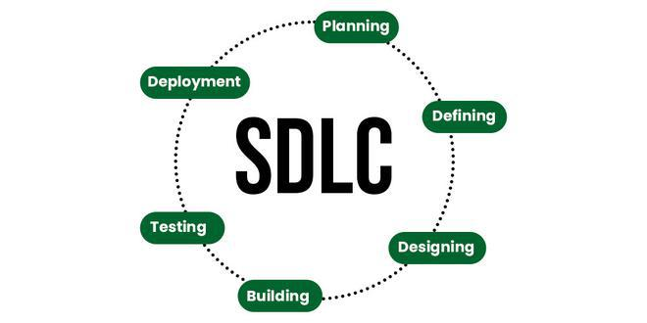
Software Development Life Cycle

Slide 4
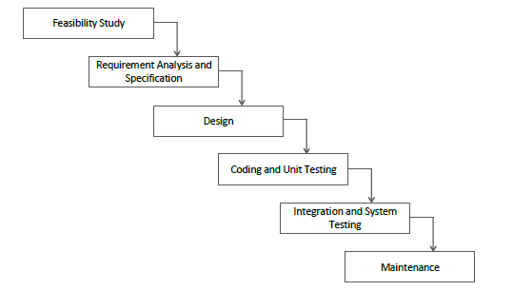
Classic Waterfall Model:

Slide 5
ADVANTAGES:
1.Base Model.
2.Simple and Easy.
3.Small Projects.
DISADVANTAGES:
1.No Feedback.
2.No Experiment.
3.No Parallelism.
4.High Risk.
5.Rigid model.

Slide 6
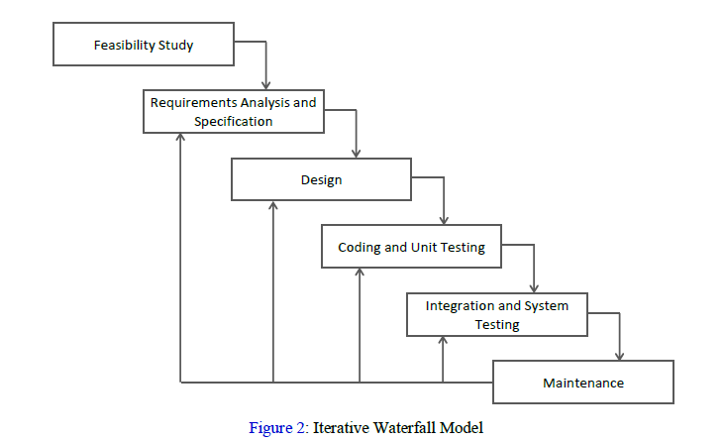
ITERACTIVE MODEL

Slide 7
ADVANTAGES:
1.Base Model.
2.Simple and Easy.
3.Small Projects.
4.Feedback.
DISADVANTAGES:
1.No Phase Overlapping.
2.Rigid(No change).
3.Less Customer Interaction.
4.No Intermediate Delivery.

Slide 8
V SHAPED MODEL
Also Known as Verification and Validation Model.
Extension of Waterfall Model.
Testing is Associated with Every phase of Lifecycle.
Verification Phase(Requirement analysis, System design, Architecture design, Module design).
Validation Phase(Unit Testing, Integration, System, Acceptance Testing.

Slide 9
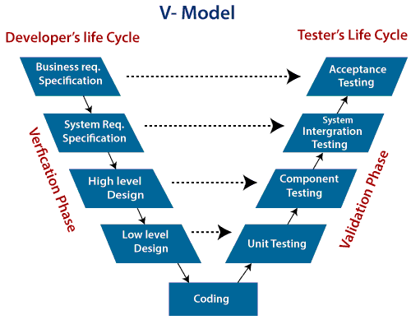
V MODEL ARCHITECTURE

Slide 10
ADVANTAGES:
1.Time Saving
2.Good Understanding of Project in the beginning
3.Every Component must be testable.
4.Progress can be tracked easily.
5.Proactive defect tracking.
DISADVANTAGES:
1.No feedback so less Scope of changes.
2.Risk analysis not done
3. Not good for big or Object Oriented Projects.

Slide 11
INCREMENTAL MODEL
Incremental Model is a process of software development where requirements divided into multiple standalone modules of the software development cycle. In this model, each module goes through the requirements, design, implementation and testing phases. Every subsequent release of the module adds function to the previous release. The process continues until the complete system achieved.

Slide 12
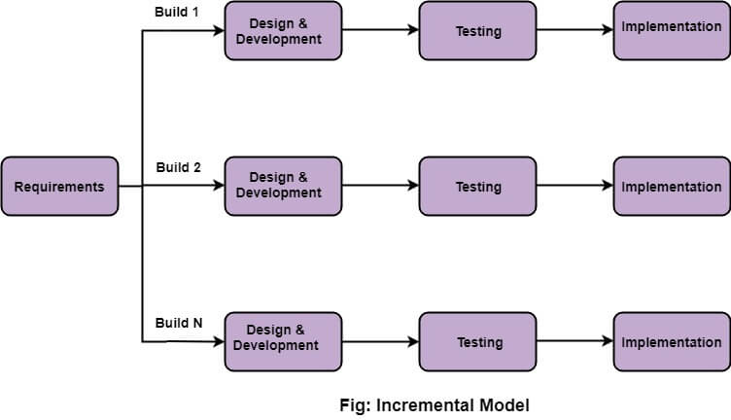
INCREMENTAL MODEL ARCHITECTURE

Slide 13
ADVANTAGES:
1.It is good to use when projects having lengthy developments schedules.
2. It can deduct errors easily because core modules are used by the customer from the beginning of the phase.
3. It is easy to manage risk because of iterations.
DISADVANTAGES:
1. It requires a good planning designing.
2. It is costlier than waterfall model.
3. Increased complexity.

Slide 14
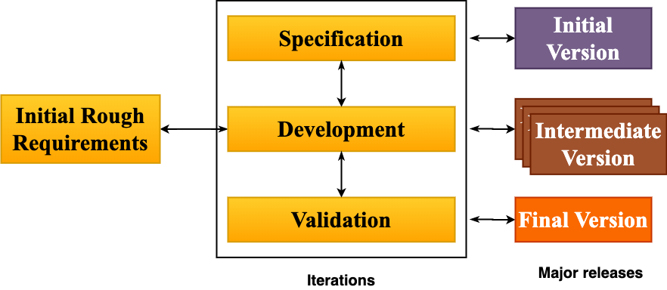
EVOLUTIONARY MODEL

Slide 15
ADVANTAGES:
1.Risk analysis is better.
2.It supports changing environment.
3.Initial operating time is less.
4.Better suited for large mission-critical projects.
5.During the life cycle software is produced early which facilitates customer evaluation and feedback.
DISADVANTAGES:
1.Management complexity is more.
2.Not suitable for smaller projects.
3.Can be costly to use.
4.Highly skilled resources are required for risk
analysis.

Slide 16
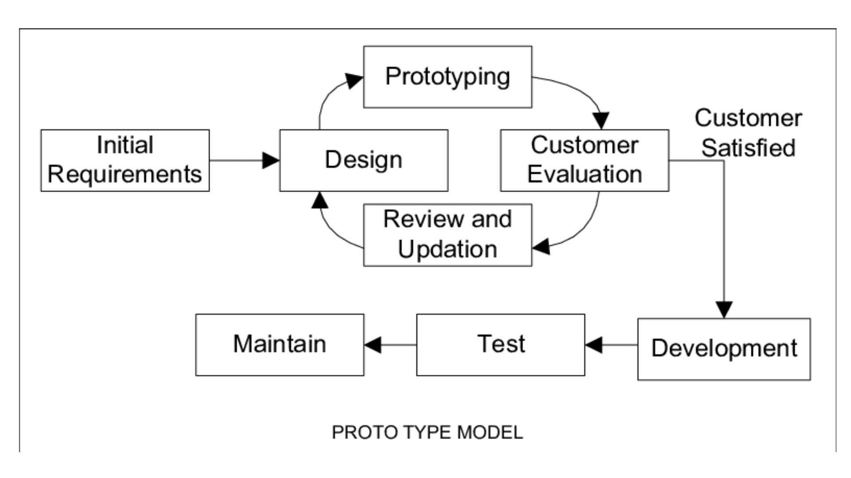
PROTOTYPE MODEL

Slide 17
ADVANTAGES:
1.This model is flexible in design.
2.It is easy to detect errors.
3.We can find missing functionality easily.
4.It can be reused by the developer for more complicated projects in the future.
DISADVANTAGES:
1. This model is costly.
2. It has poor documentation because of continuously
changing customer requirements.
3.There may be too much variation in requirements.
4.There may increase the complexity of the system.

Slide 18
RAPID APPLICATION DEVELOPMENT(RAD)
1. Gathering requirements using workshops or focus groups
2. Prototyping and early, reiterative user testing of designs
3. The re-use of software components
4. A rigidly paced schedule that refers design improvements to the next product version
5. Less formality in reviews and other team communication

Slide 19
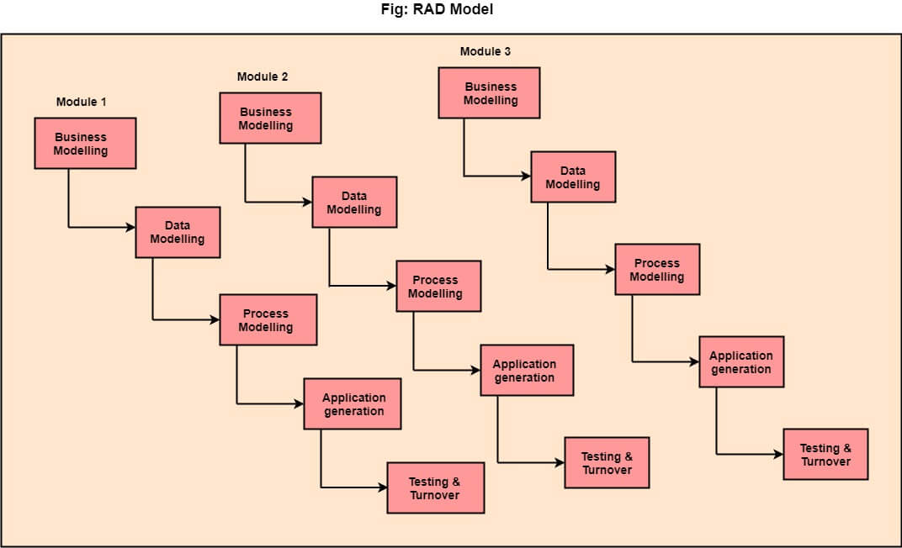
RAD Model Diagram

Slide 20
ADVANTAGES:
1. This model is flexible for change.
2. In this model, changes are adoptable.
3. It reduced development time.
4. It increases the reusability of features.
DISADVANTAGES:
1. All application is not compatible with RAD.
2. It required highly skilled designers.
3. It required highly skilled designers.
4. On the high technical risk, it's not suitable.

Slide 21
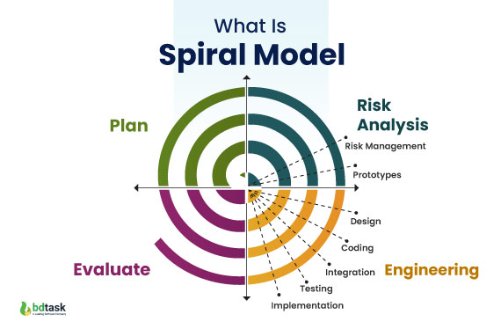
SPIRAL MODEL
Radius of the spiral= Cost
Angular Dimension= Progress

Slide 22
ADVANTAGES:
1. Software is produced early in the software life cycle.
2.Risk Handling.
3.It is used in Large projects.
4.It is Flexible changes.
5.Customer Satisfaction
DISADVANTAGES:
1.It is very complex.
2.Expensive.
3.Too much risk analysis.
4.Time consumption is very high.

Slide 23
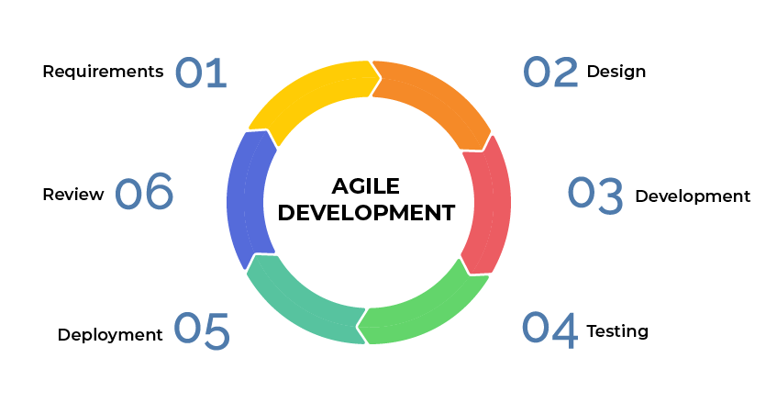
AGILE METHODOLOGY

Slide 24
ADVANTAGES:
1.Frequent Delivery.
2.Face to face communication with client.
3.In between changes are allowed.
DISADVANTAGES:
1. More time and commitment. ...
2. Lack of necessary documentation. ...
3. Less predictable.
4. Maintenance Problem.

Slide 25
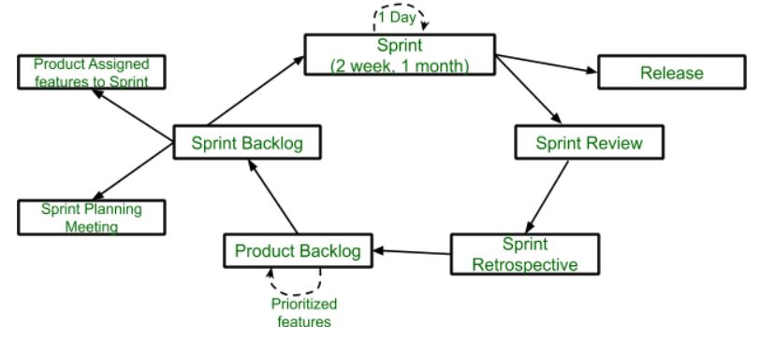
SCRUM

Slide 26
Key points:
One of the most Popular agile methodology.
Scrum is the lightweight, iterative and incremental framework.
Scrum breaks down the development phases into stages or cycles called “Sprints”.
The development time for each sprint is maximizd and dedicated, there by managing only one sprint at a time.
Scrum team has scrum master and product owner with constant communications on the daily basis.
Keywords: Backlog, Sprint, Daily Scrum, Scrum master, Product Owner.

Slide 27
ADVANTAGES:
1.Freedom & Adaption
2. High quality, Low risk product.
3. Reduce the development time.
4. Scrum customer satisfaction is very important.
5. Reviewing the current sprint before moving to new one.
DISADVANTAGES:
1. More efficient for small team size.
2. No changes in the sprint.

